Slide 1
INHERITANCE

Slide 2
Method Overriding in Java If subclass (child class) has the same method as declared in the parent class, it is known as method overriding in Java. In other words, If a subclass provides the specific implementation of the method that has been declared by one of its parent class, it is known as method overriding. Usage of Java Method Overriding Method overriding is used to provide the specific implementation of a method which is already provided by its superclass. Method overriding is used for runtime polymorphism Rules for Java Method Overriding The method must have the same name as in the parent class The method must have the same parameter as in the parent class. There must be an IS-A relationship (inheritance).

Slide 3
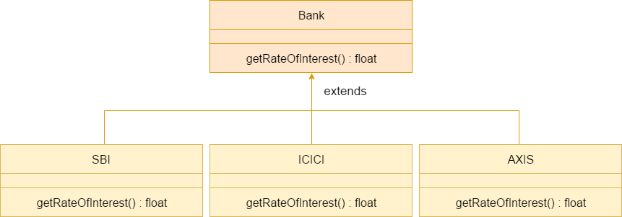
A real example of Java Method Overriding
Consider a scenario where Bank is a class that provides functionality to get the rate of interest. However, the rate of interest varies according to banks. For example, SBI, ICICI and AXIS banks could provide 8%, 7%, and 9% rate of interest.

Slide 4
//Java Program to demonstrate the real scenario of Java Method Overriding //where three classes are overriding the method of a parent class. //Creating a parent class. class Bank{ int getRateOfInterest() {return 0;} } //Creating child classes. class SBI extends Bank{ int getRateOfInterest(){return 8;} } class ICICI extends Bank{ int getRateOfInterest(){return 7;} } class AXIS extends Bank{ int getRateOfInterest(){return 9;} } }

Slide 5
//Test class to create objects and call the methods class Test2{ public static void main(String args[]){ SBI s=new SBI(); ICICI i=new ICICI(); AXIS a=new AXIS(); System.out.println("SBI Rate of Interest: "+s.getRateOfInterest()); System.out.println("ICICI Rate of Interest: "+i.getRateOfInterest()); System.out.println("AXIS Rate of Interest: "+a.getRateOfInterest()); }

Slide 6
Can we override static method? No, a static method cannot be overridden. It can be proved by runtime polymorphism, so we will learn it later. Why can we not override static method? It is because the static method is bound with class whereas instance method is bound with an object. Static belongs to the class area, and an instance belongs to the heap area. Can we override java main method? No, because the main is a static method.

Slide 7
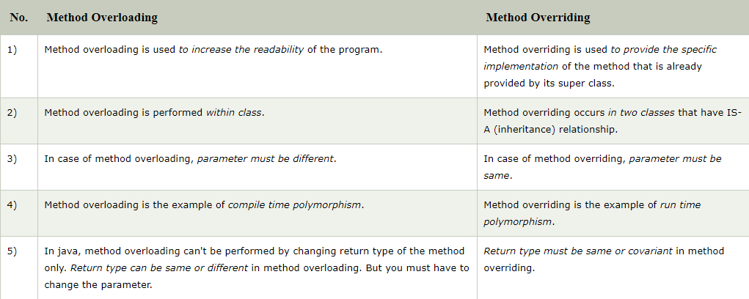
Differences between method Overloading and Method Overriding in java

Slide 8
THANK YOU

